Slide 1
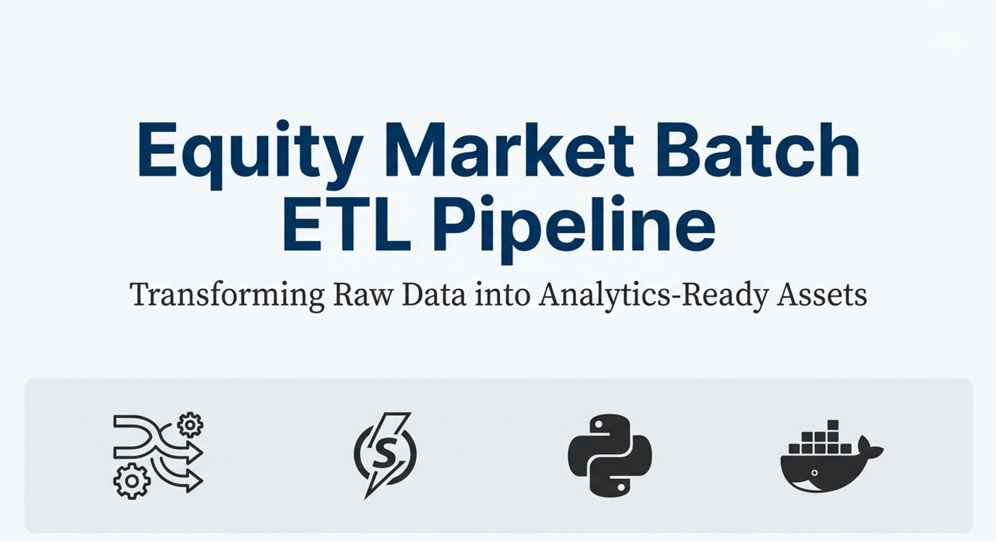
Presented by [Kaiqiang Zheng]
Notes:
Today I’ll walk through a batch ETL pipeline I built for equity market data.
The goal of this project is to transform raw daily stock price files into analytics-ready datasets using a production-style architecture with Airflow and Spark.

Slide 2
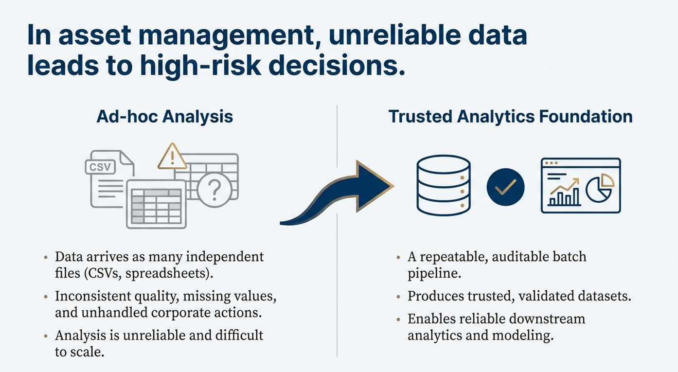
Notes:
In asset management, investment and research teams rely heavily on accurate and reproducible market data.
However, raw market data often arrives as many independent files, with inconsistent quality, missing values, and corporate actions such as splits and dividends.
This makes ad-hoc analysis unreliable and difficult to scale.
The motivation of this project is to build a repeatable, auditable batch pipeline that produces trusted datasets for downstream analytics.

Slide 3
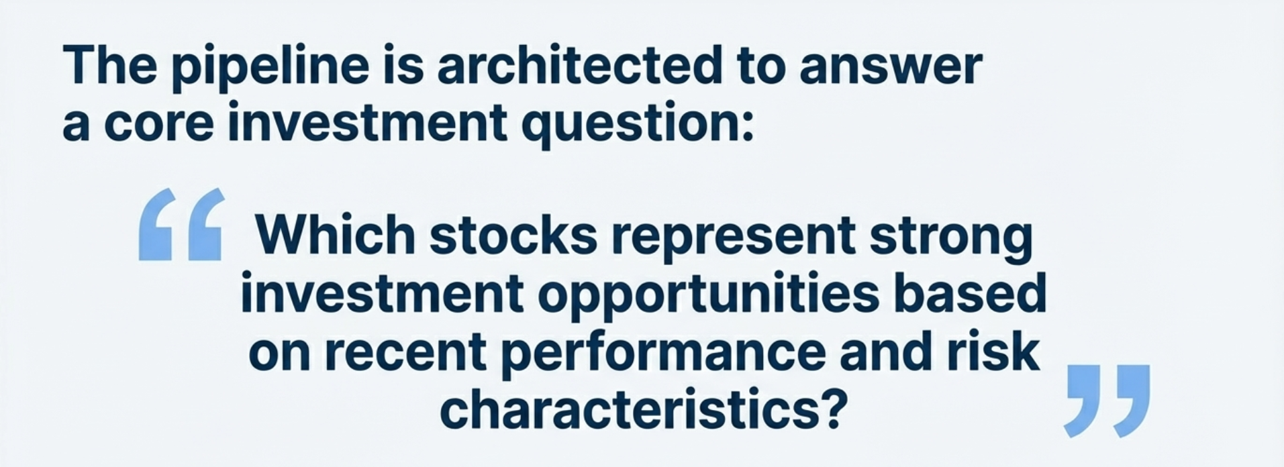
Notes:
This question can be analyzed at different levels — across the entire market, by sector, by industry, or even by ETFs.
To answer this reliably, we need clean, joined, and analytics-ready market data.

Slide 4
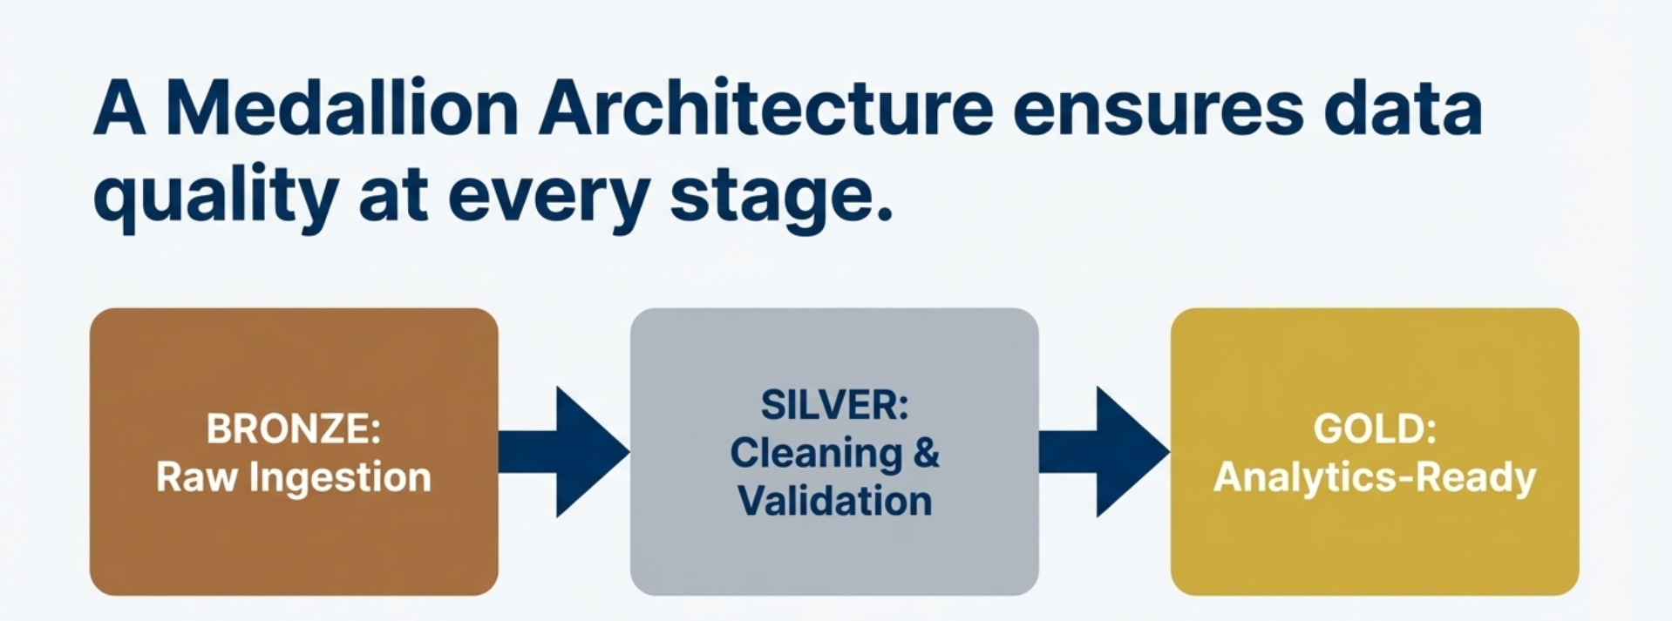
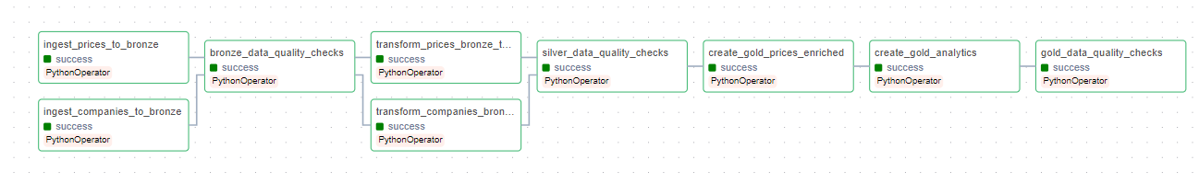
Notes:
The pipeline follows a Medallion Architecture with Bronze, Silver, and Gold layers.
The Bronze layer preserves raw data as-is for auditability.
The Silver layer applies schema normalization, deduplication, and business-rule validation to produce trusted datasets.
The Gold layer enriches the data and computes analytics-ready metrics for consumption by analysts or downstream systems.

Slide 5
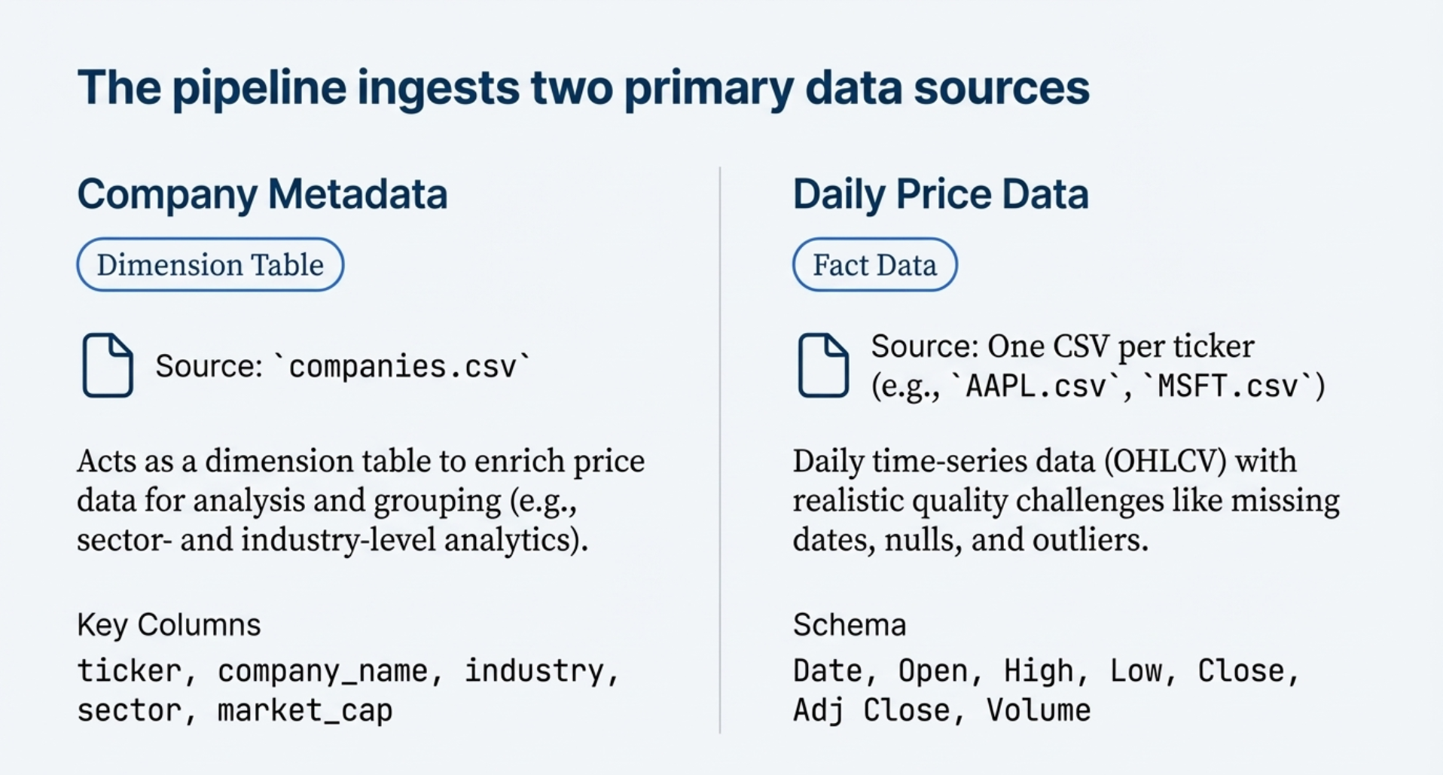
Notes:
The pipeline ingests two primary data sources.
First, company reference data, which includes sector, industry, exchange, and market capitalization. This acts as a dimension table.
Second, daily price data, where each ticker is delivered as a separate CSV file containing OHLCV values.
This file-per-ticker structure is common in financial data and scales naturally as new assets are added.

Slide 6
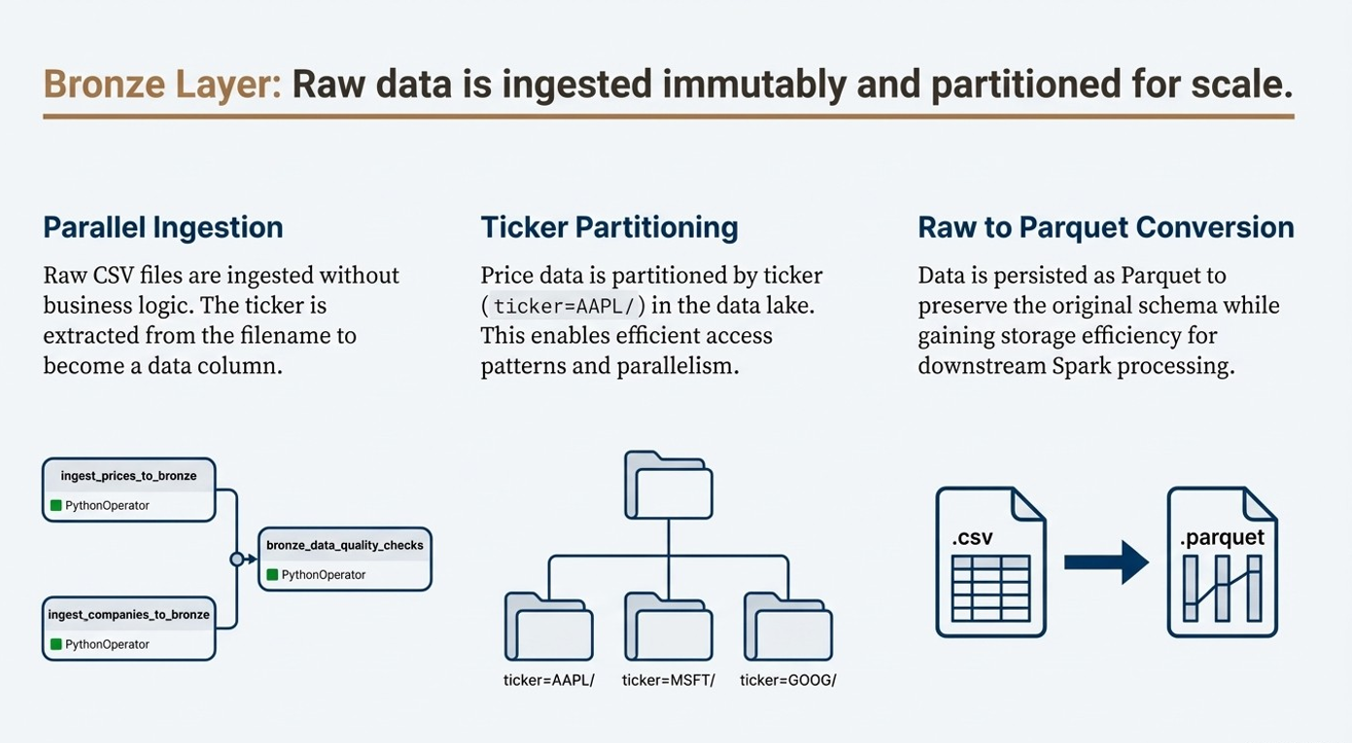
Notes:
In the Bronze layer, raw CSV files are ingested and persisted as Parquet without applying any business logic.
For price data, the ticker symbol is extracted from the file name and stored as a column, which enables partitioning and scalability.
Parquet is used at this stage purely for efficient storage and downstream processing, while preserving the original data semantics.
No transformations or filters are applied at this stage — the goal is to preserve the raw source for reproducibility and reprocessing.

Slide 7
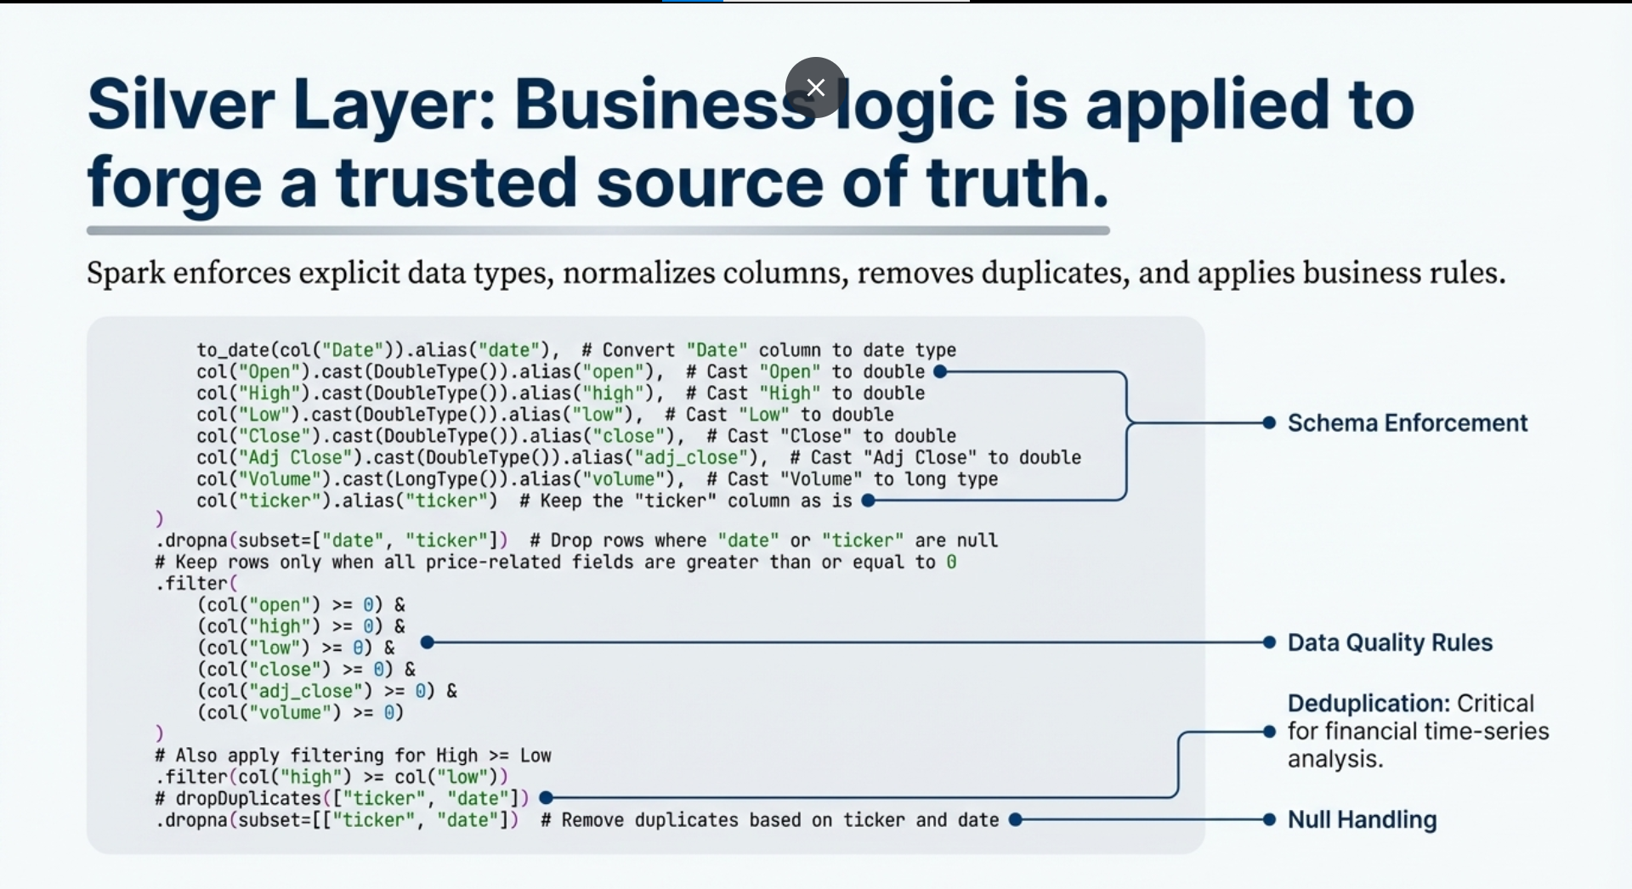
Notes:
The Silver layer is where data becomes trustworthy.
Here, Spark enforces explicit data types, normalizes column names, removes duplicates, and applies business rules such as non-negative prices and valid trading volumes.
This layer also ensures that each ticker has at most one record per trading day, which is critical for financial time-series analysis.

Slide 8
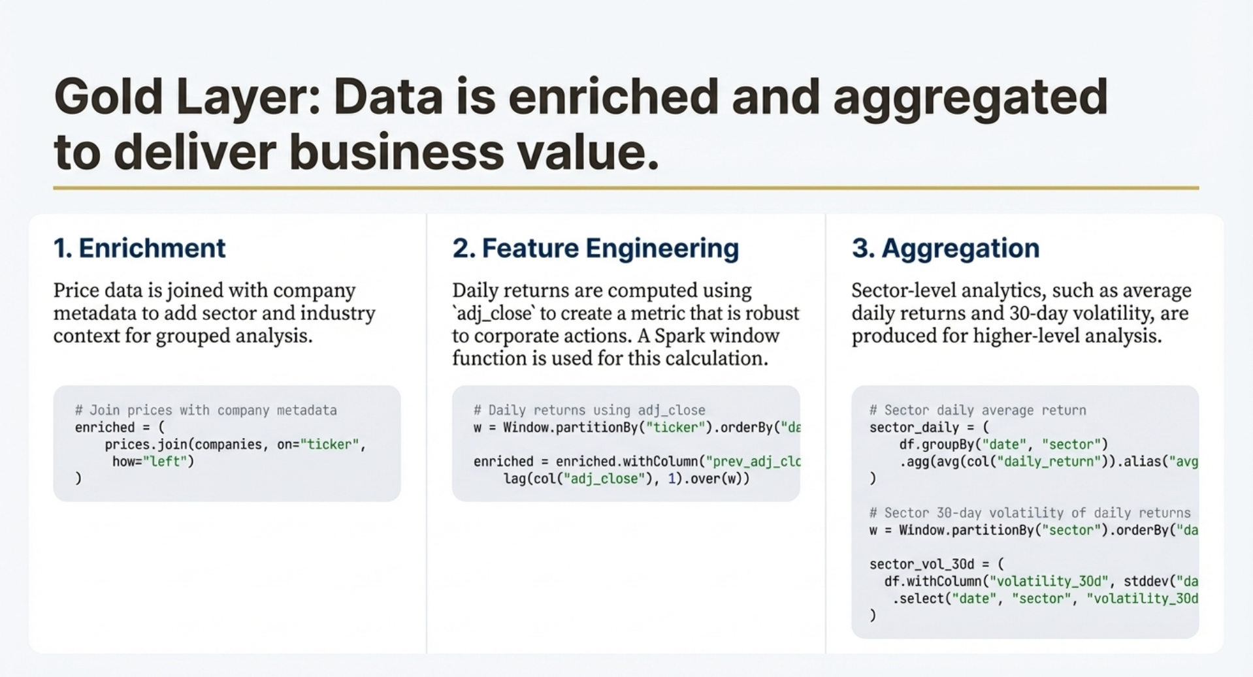
Notes:
In the Gold layer, price data is joined with company metadata to enrich each record with sector and industry information.
Using adjusted close prices, the pipeline computes daily returns, which are robust to corporate actions.
In addition, aggregated analytics such as sector-level average returns are produced for downstream analysis and reporting.

Slide 9
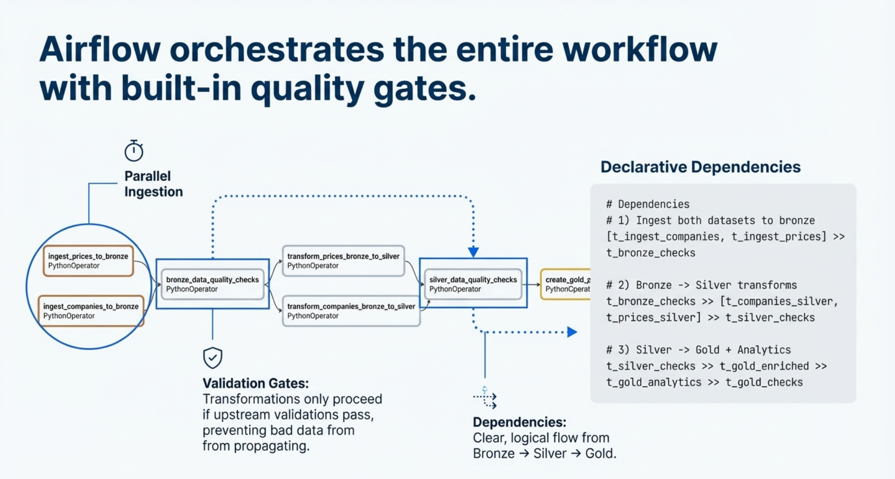
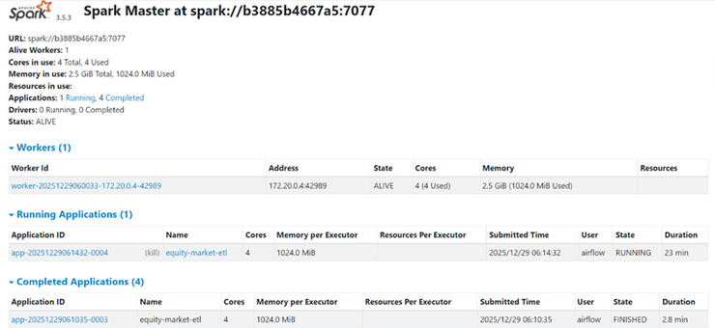
Notes:
Airflow Pipeline Orchestration
Airflow manages the entire pipeline through a daily batch Directed Acyclic Graph (DAG).
Ingestion tasks for prices and companies run in parallel, followed by quality checks that act as gates between layers.
Transformations will only take place if the upstream validations are successful, ensuring that faulty data does not continue downstream.
- Operational Robustness:
- The DAG is equipped with retry logic and failure callbacks to enhance reliability.

Slide 10
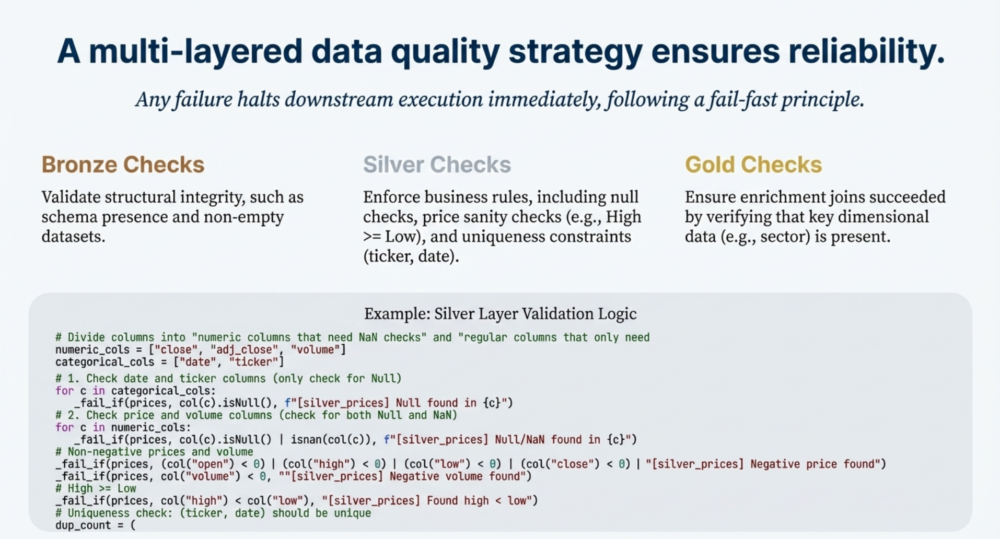
Notes:
Data quality is enforced at multiple stages.
Bronze checks validate structural integrity, such as schema presence and non-empty datasets.
Silver checks enforce business rules, including null checks, price sanity checks, and uniqueness constraints.
Gold checks ensure enrichment joins succeeded, for example by verifying that sector information is present.
Any failure halts downstream execution immediately.

Slide 11
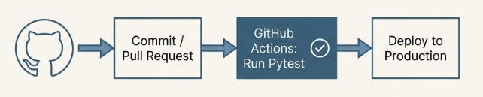

Unit Testing & CI/CD Readiness
CI/CD READY
The project's design allows for easy integration into a GitHub Actions workflow.
AUTOMATION
Tests can be executed automatically on each commit or pull request before deployment.
RESULT
This creates a safety net, preventing quality regressions and ensuring only validated code reaches production.
Notes:
In addition to the pipeline itself, the project also includes unit tests to support future CI/CD integration.
Pytest is used to validate configuration logic and data quality rules independently from Airflow execution.
These tests reuse the same data quality functions that are executed in the production DAG, which ensures consistency between development, testing, and runtime behavior.
This design allows the project to be easily integrated into a GitHub Actions workflow, where tests can be executed automatically on each commit or pull request before deployment.

Slide 12
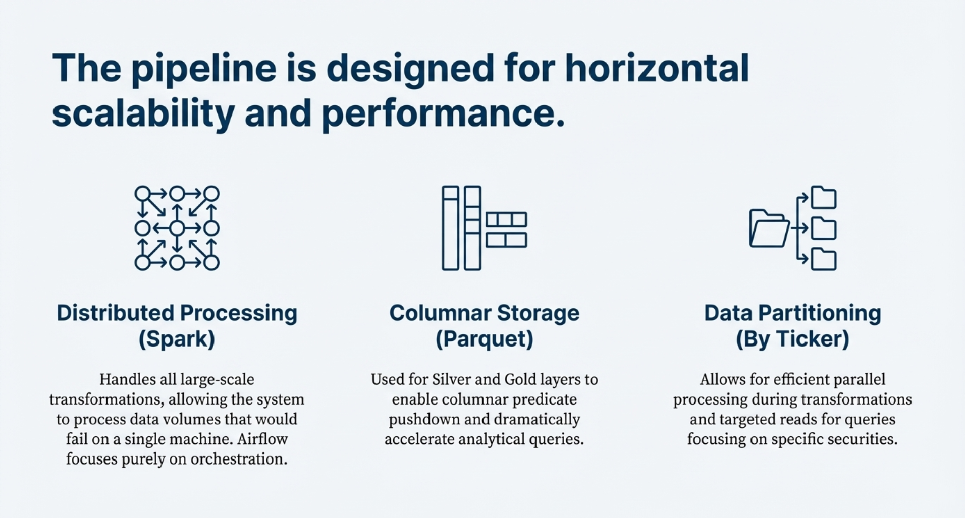
Notes:
The pipeline is designed to scale horizontally.
Partitioning by ticker allows efficient access patterns and parallelism.
All 3 layers use the parquet storage format. Parquet is used for Silver and Gold layers to enable columnar storage and efficient analytics.
Spark handles all large-scale transformations, while Airflow focuses purely on orchestration.

Slide 13
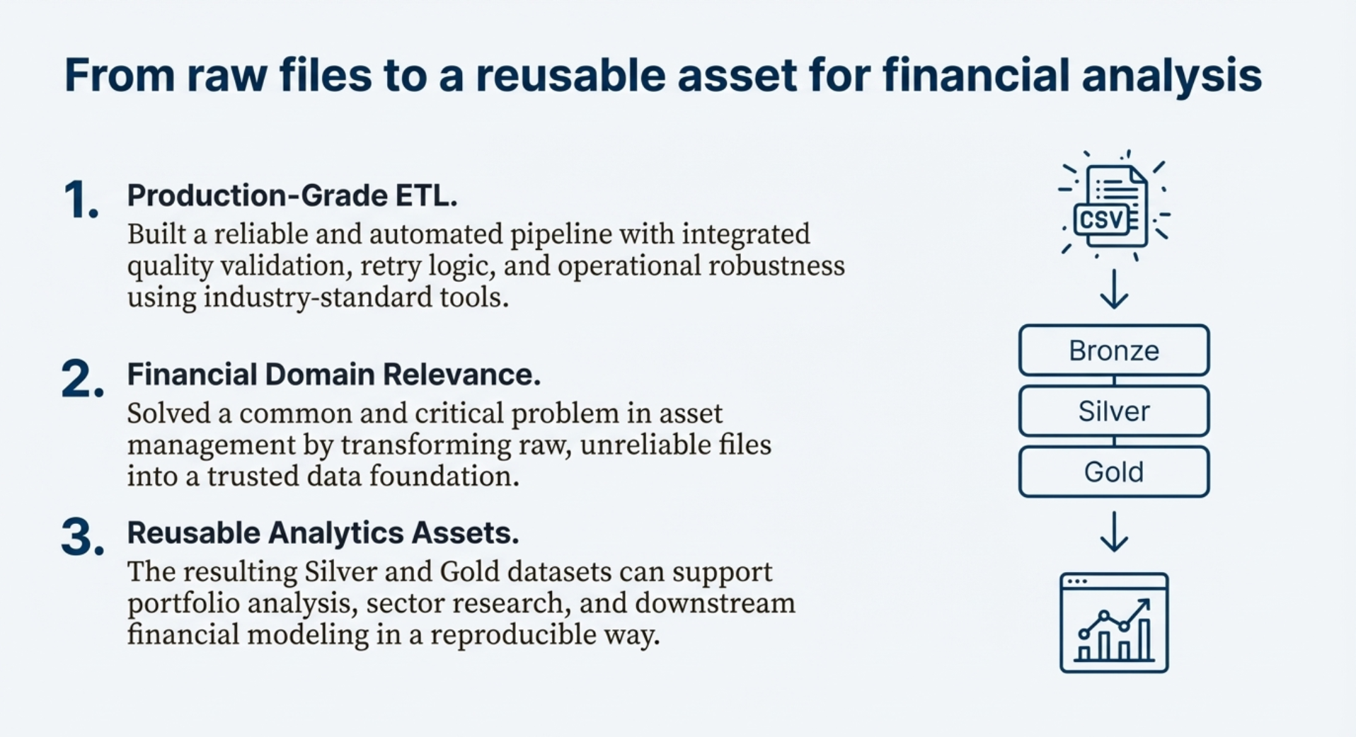
Notes:
In summary, this project demonstrates a production-style batch ETL pipeline for financial market data.
It integrates raw data ingestion, automated quality validation, scalable transformations, and analytics-ready outputs using industry-standard tools.
The resulting datasets can support portfolio analysis, sector research, and downstream financial modeling in a reliable and reproducible way.

Slide 14
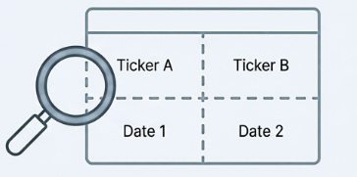
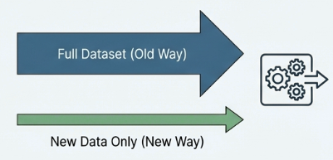
Tactical Optimizations
Initiatives 1: Smart Partitioning
Action: Partition data by key dimensions like ticker and date ranges.
Impact: Significantly reduces scan costs for common analytical queries, making data access faster and cheaper.
Initiatives 2: Incremental Processing
Action: Re-architect jobs to process only newly arrived market data.
Impact: Eliminates the need to reprocess the full dataset each day, drastically cutting down on compute time and resource consumption.
Notes:
From a performance perspective, smarter partitioning strategies can be applied, such as partitioning by ticker and date ranges, to reduce scan costs for analytical queries.
Incremental processing could also be introduced so that only newly arrived market data is processed instead of reprocessing the full dataset each day.

Slide 15

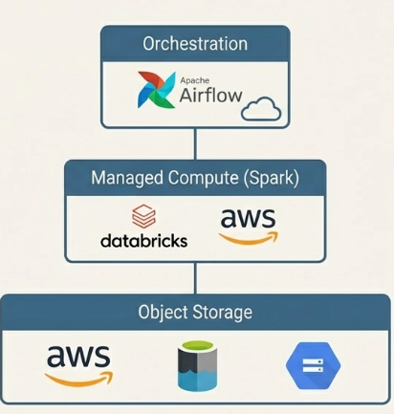
Improvements
Initiatives 1: Migrate to Object Storage
Action: Move data persistence from traditional storage to a cloud-based object store.
Platforms: S3, ADLS, or GCS.
Impact: Enables support for massive data volumes with superior scalability and durability.
Initiatives 2: Adopt Managed Platforms
Action: Leverage managed Spark and Airflow services.
Platforms: Databricks or EMR for Spark; Managed Airflow.
Impact: Provides elastic scaling on demand, reduces infrastructure management overhead, and improves overall platform resilience.
Notes:
From an infrastructure perspective, the pipeline can be migrated to cloud-native services, such as object storage and managed Spark platforms, to support larger data volumes and elastic scaling.

Slide 16
Thank You
Appreciate your attention and welcome any further questions regarding the presentation.
Notes:
Thank you.

